Slide 1
Database Systems and Applications

Slide 2

WHAT IS A DATABASE?
https://www.youtube.com/watch?v=wR0jg0eQsZA

Slide 3

1. DATA MANAGEMENT

Slide 4

Without data and the ability to process it, an organization cannot successfully complete most business activities. It cannot pay employees, send out bills, order new inventory, or produce information to assist managers in decision making. As you recall, data consists of raw facts, such as employee numbers and sales figures. For data to be transformed into useful information, it must first be organized in a meaningful way.

Slide 5

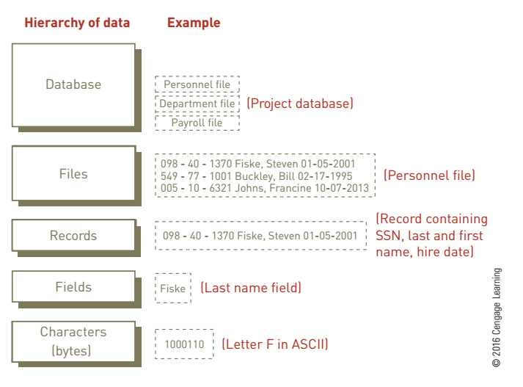
Hierarchy of Data
Data starts off small with bits, then characters, then fields, records, files, and database.
Notes:
Data is generally organized in a hierarchy that begins with the smallest piece of data used by computers (a bit) and progresses through the hierarchy to a database. A bit (a binary digit) represents a circuit that is either on or off. Bits can be organized into units called bytes. A byte is typically eight bits.
Characters are put together to form a field. A field is typically a name, number, or combination of characters that describes an aspect of a business object
In addition to being entered into a database, fields can be computed from other fields. Computed fields include the total, average, maximum, and minimum value. A collection of data fields all related to one object, activity, or individual is called a record. By combining descriptions of the characteristics of an object, activity, or individual, a record can provide a complete description of it.
A collection of related records is a file—for example, an employee file is a collection of all company employee records.
Most database software refers to files as tables.
At the highest level of the data hierarchy is a database, a collection of integrated and related files. Together, bits, characters, fields, records, files, and databases form the hierarchy of data.
Characters are combined to make a field, fields are combined to make a record, records are combined to make a file, and files are combined to make a database. A database houses not only all these levels of data but also the relationships among them.

Slide 6
2. DATA ENTITIES
Attributes and Keys

Slide 7
DATA ENTITIES, ATTRIBUTES AND KEYS
ENTITIES
ATTRIBUTES
KEYS
Notes:
An entity is a person, place, or thing (object) for which data is collected, stored, and maintained. Examples of entities include employees, products, and plants. Most organizations organize and store data as entities.
An attribute is a characteristic of an entity. For example, employee number, last name, first name, hire date, and department number are attributes for an employee. The inventory number, description, number of units on hand, and location of the inventory item in the warehouse are attributes for items in inventory. Customer number, name, address, phone number, credit rating, and contact person are attributes for customers. Attributes are usually selected to reflect the relevant characteristics of entities such as employees or customers. The specific value of an attribute, called a data item, can be found in the fields of the record describing an entity.
As discussed earlier, a collection of fields about a specific object is a record. A primary key is a field or set of fields that uniquely identifies the record. No other record can have the same primary key.

Slide 8

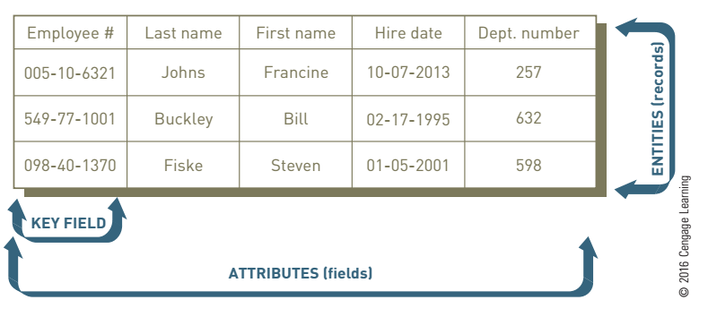
DATA ENTITIES, ATTRIBUTES AND KEYS

Slide 9
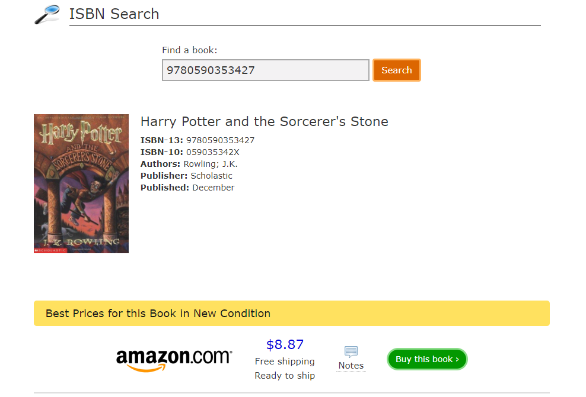
DATA ENTITIES, ATTRIBUTES AND KEYS
Notes:
This is an example of a primary key. There is only one ISBN that is Harry Potter and the Sorcerer’s Stone and this website is able to search all sellers based on the ISBN.

Slide 10
2. The Database Approach

Slide 11
The Database Approach
Traditional Approach to Data Management
Database Approach to Data Management
Database Management System (DBMS)
Notes:
traditional approach to data management: An approach to data management whereby each distinct operational system uses data files dedicated to that system.
Today, most organizations use the database approach to data management, where multiple information systems share a pool of related data. A database offers the ability to share data and information resources.
To use the database approach to data management, additional software— a database management system (DBMS)—is required. A DBMS consists of a group of programs that can be used as an interface between a database and the user of the database. Typically, this software acts as a buffer between the application programs and the database itself.

Slide 12
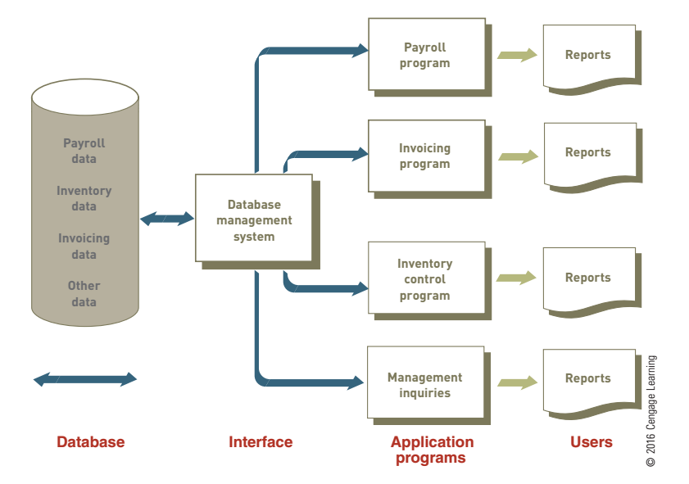
The Database Approach
Notes:
Here is an example of a database, DBMS, application using the DB, and the user.

Slide 13

3. DATA MODELING
The act of designing and maintaining a database.
Notes:
Because today’s businesses must keep track of and analyze so much data, they must keep the data well organized so that it can be used effectively. A database should be designed to store all data relevant to the business and provide quick access and easy modification. Moreover, it must reflect the business processes of the organization.

Slide 14
DATA MODELING
When building a database, an organization must carefully consider these questions:
Content. What data should be collected and at what cost?
Access. What data should be provided to which users and when?
Logical structure. How should data be arranged so that it makes sense to a given user?
Physical organization. Where should data be physically located?

Slide 15
DATA MODELS
Data Model
A data model is a diagram of the entities and their relationships.
Enterprise Data Modeling
Data modeling that is done at the level of the entire enterprise.

Slide 16
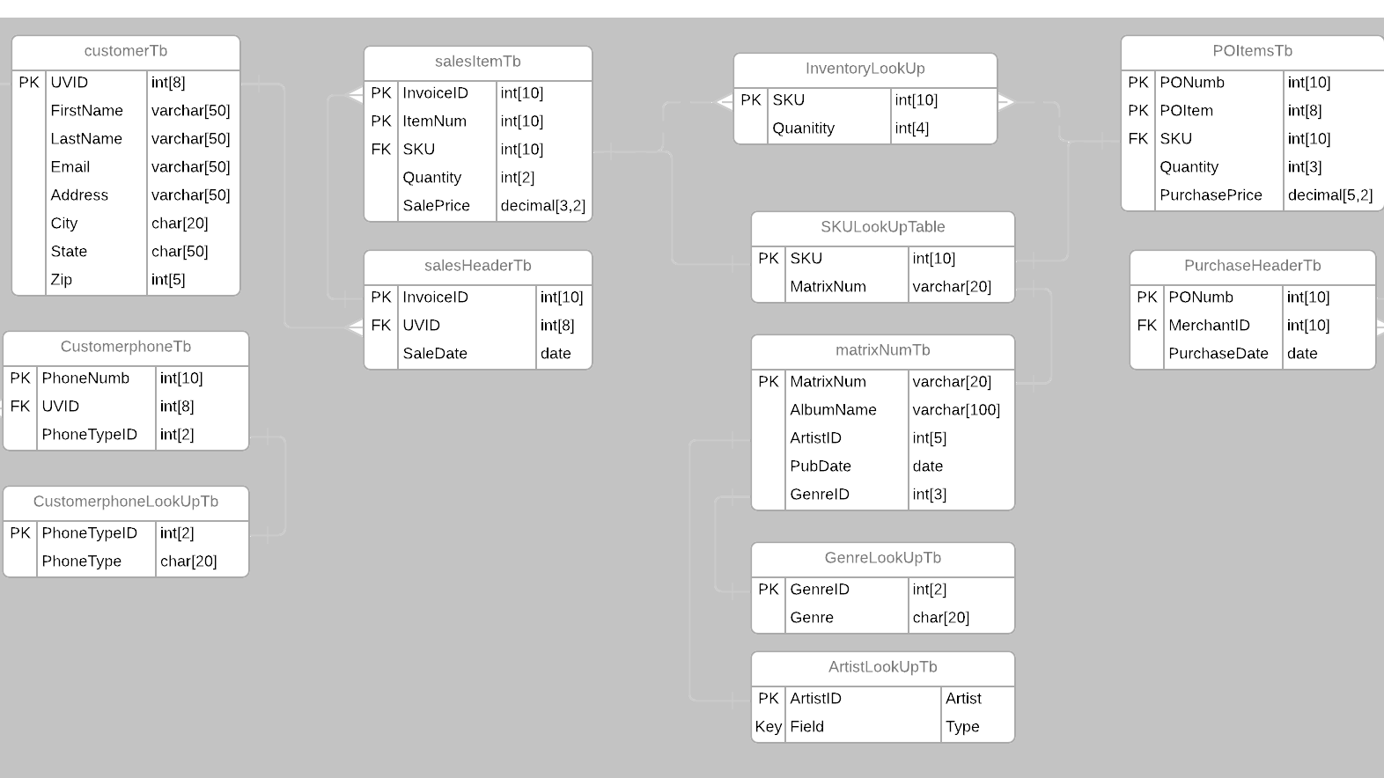
This is an ERD
Notes:
Entity-relationship (ER) diagrams use basic graphical symbols to show the organization of and relationships between data. In other words, ER diagrams show data items in tables (entities) and the ways they are related. ER diagrams help ensure that the relationships among the data entities in a database are correctly structured so that any application programs developed are consistent with business operations and user needs. In addition, ER diagrams can serve as reference documents after a database is in use. If changes are made to the database, ER diagrams help design them.

Slide 17
4. Relational Database Model

Slide 18

Relational Database Model
Relational Model
Using two dimensional tables to organize collections of data
Domain
The domain for a particular attribute indicates what values can be placed in each column of the relational table.
Notes:
The relational model is a simple but highly useful way to organize data into collections of two dimensional tables called relations. Each row in the table represents an entity, and each column represents an attribute of that entity. Databases based on the relational model include Oracle, IBM DB2, Microsoft SQL Server, Microsoft Access, MySQL, and Sybase. Oracle holds 48 percent of the 2012 worldwide relational database management systems market share according to market research firm Gartner. This is a larger market share than its four closest competitors combined (IBM, Microsoft, SAP, and Teradata).
The domain for a particular attribute indicates what values can be placed in each column of the relational table. For instance, the domain for an attribute such as gender could be limited to the two characters M (male) or F (female). If someone tried to enter a“1”in the gender field, the data would not be accepted. The domain for pay rate would not include negative numbers. In this way, defining a domain can increase data accuracy.
The domain is basically the datatype for the column, examples of data types:
Int, money, decimal, date, datetime, char, varchar and a lot of others.

Slide 19
Manipulating Data
Different ways to manipulate the data within a Database:
Selecting: Manipulating data to eliminate rows according to certain criteria.
Projecting: Manipulating data to eliminate columns in a table.
Joining: Manipulating data to combine two or more tables.
Linking: The ability to combine two or more tables through common data attributes to form a new table with only the unique data attributes.

Slide 20
Manipulating Data: Selecting
Example of a select statement:
SELECT UVID, FirstName, LastName
FROM customerTb;
Notes:
Prints UVID, first name, last name of everyone in the customer table

Slide 21
Manipulating Data: Projecting
Example of a projecting statement:
SELECT UVID, FirstName, LastName
INTO customerNameTb
FROM customerTb;
Notes:
Takes UVID, first name, and last name of all customers and puts into a new table called customerNameTb

Slide 22
Manipulating Data: Joining
Example of a join statement:
SELECT c.UVID, c.FirstName, s.InvoiceID
FROM customerTb c
RIGHT JOIN salesHeaderTb s on c.UVID=s.UVID;
Notes:
This will print uvid, first name and invoice id from all purchases.

Slide 23
Manipulating Data: Linking
Example of a linking statement:
SELECT c.UVID, c.FirstName, COUNT(s.InvoiceID)
FROM customerTb c
LEFT JOIN salesHeaderTb s on c.UVID=s.UVID
GROUP BY c.UVID, c.FirstName;
Notes:
This will print any uvid that has 0 purchases.

Slide 24
Manipulating Data: Data Cleansing
Data cleansing (data cleaning or data scrubbing) is the process of detecting and then correcting or deleting incomplete, incorrect, inaccurate, irrelevant records that reside in a database. The goal is to improve the quality of the data used in decision making. The“bad data”may have been caused by user data entry errors or by data corruption during data transmission or storage. Data cleansing is different from data validation, which involves the identification of “bad data” and its rejection at the time of data entry.
Notes:
This will print any uvid that has 0 purchases.

Slide 25
Manipulating Data: Data Cleansing
Example of a cleansing statement:
SELECT customerTb
SET Address = Street
WHERE Address like ‘%str%’;
Notes:
Update the address of the customer table to be street instead of an abbreviation.

Slide 26
5. Database Management Systems
Managing all sorts of Databases

Slide 27
Database Management System: Types
Single-User DBMS
A database installed on a personal computer is typically meant for a single user. This means that when user A is accessing the database, user B must wait until user A is finished.
Multiple-User DBMS
Small, midsize, and large businesses need multiuser DBMSs to share information throughout the organization over a network. These more powerful, expensive systems allow dozens or hundreds of people to access the same database system at the same time.
Flat Files
A flat file is a simple database program whose records have no relationship to one another. Flat file databases are often used to store and manipulate a single table or file. Many spreadsheet and word-processing programs have flat file capabilities. These software packages can sort records and make simple calculations and comparisons.

Slide 28
Database Management System: SQL
SQL (Structured Query Language) is a special purpose programming language for accessing and manipulating data stored in a relational database. It was originally defined by Donald D. Chamberlin and Raymond Boyce of the IBM Research Center.

Slide 29
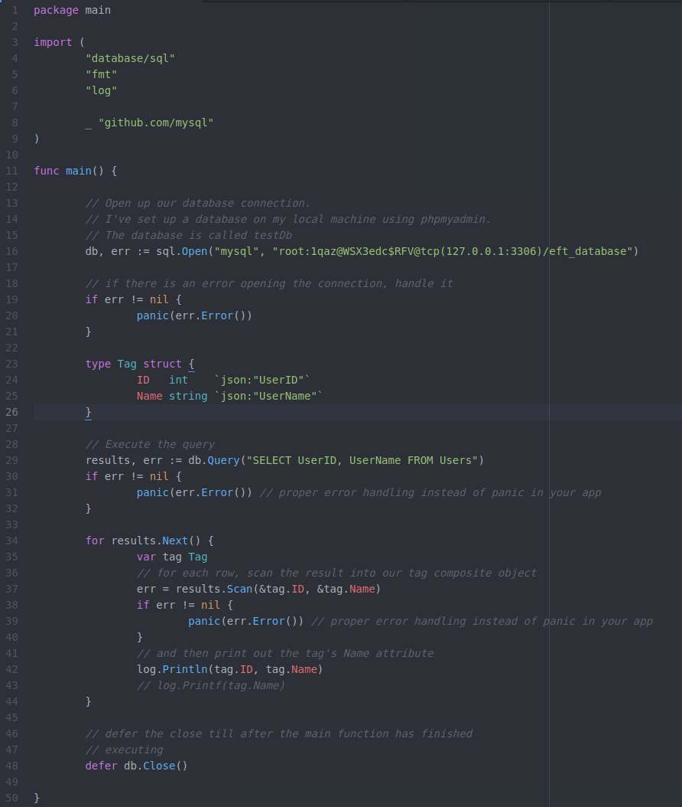
Using SQL within a Programming Language (Go)
Notes:
SQL lets programmers learn one powerful query language and use it on systems ranging from PCs to the largest mainframe computers. See Figure 3.11. Programmers and database users also find SQL valuable because SQL statements can be embedded into many programming languages, such as the widely used Cþþ, Java, and other languages. Because SQL uses standardized and simplified procedures for retrieving, storing, and manipulating data, the popular database query language can be easy to understand and use.

Slide 30
Database Management System: NoSQL
A NoSQL database is designed to store and retrieve data in a manner that does not rigidly enforce the atomic conditions associated with the relational database model. The goal of a NoSQL database is to provide faster performance and greater scalability. NoSQL databases lack strong data consistency—the ability to ensure that an update to data in one part of the database is immediately propagated to all other parts of the database. NoSQL databases are finding significant and growing industry use in dealing with extremely large database and real-time Web applications.
Notes:
A NoSQL database stores data as highly optimized key-value stores wherein the data is stored in a simple two-column table with one column reserved for the primary key and the other for the value. A NoSQL database is highly scalable, meaning that a large database may be distributed across hundreds, thousands, or even tens of thousands of servers running the same NoSQL database management system. This distribution of the database improves system uptime as the database can still process almost all transactions even if a server or two someplace is down. (Scaling a traditional SQL database is much more complicated.). Facebook employs thousands of servers running the NoSQL database Cassandra to handle millions of queries per second and ensure around the clock processing. (this is outdated but they used to).
Hadoop is an open-source software framework including several software modules that provide a means for storing and processing extremely large data sets. For years, Yahoo used Hadoop to better personalize the ads and articles that its visitors see. Now Hadoop is used by many popular Web sites and services (eBay, Etsy, Twitter, and Yelp, to name a few). 12 Hadoop divides the data into subsets and distributes the subsets onto different servers for processing. The Hadoop MapReduce software module is a programming model designed for processing large volumes of data in parallel by dividing the work into a set of independent tasks. This approach creates a very robust computing environment that allows the application to keep running even if individual servers fail.

Slide 31
Database Management System: Others
In addition to raw data, organizations are finding a need to store large amounts of visual and audio signals in an organized fashion. Credit card companies, for example, enter pictures of charge slips into an image database using a scanner. The images can be stored in the database and later sorted by customer name, printed, and sent to customers along with their monthly statements. Image databases are also used by physicians to store X-rays and transmit them to clinics away from the main hospital. Financial services, insurance companies, and government branches are using image databases to store vital records and replace paper documents. Drug companies often need to analyze many visual images from laboratories. Visual databases can be stored in some object-relational databases or special-purpose database systems. Many relational databases can also store images.

Slide 32
6. Database Activities

Slide 33
Providing a User View
First step to using a large database involves “telling” the DBMS the logical and physical structure of the data and the relationships among the data for each user. This is the schema.

Slide 34
Creating and Modifying the Database
Schemas are entered into the DBMS (usually by database personnel) via a data definition language. A data definition language (DDL) is a collection of instructions and commands used to define and describe data and relationships in a specific database. A DDL allows the database’s creator to describe the data and relationships that are to be contained in the schema.

Slide 35
Creating and Modifying the Database
CREATE TABLE Airlines (
AirlineID INT PRIMARY KEY IDENTITY(1,1),
AirlineName VARCHAR(20)
);
GO
CREATE TABLE Planes (
PlaneID INT PRIMARY KEY IDENTITY(100,1),
Manufacturer VARCHAR(10),
ModelNum VARCHAR(20),
OriginalPurchaseDate DATE,
LastServiceDate DATE,
AirlineID INT REFERENCES Airlines(AirlineID),
NumSeats INT
);
GO
Notes:
This is an example of a DDL script that is used to create two different tables and defines the datatype for the columns as well as the primary and foreign keys.

Slide 36
Creating and Modifying the Database
Another important step in creating a database is to establish a data dictionary, a detailed description of all data used in the database. The data dictionary contains the following information:
Notes:
This is an example of a DDL script that is used to create two different tables and defines the datatype for the columns as well as the primary and foreign keys.

Slide 37
Cont.
Name of the data item
Aliases or other names that may be used to describe the item
Range of values that can be used
Type of data (such as alphanumeric or numeric)
Amount of storage needed for the item
Notation of the person responsible for updating it and the various users who can access it
List of reports that use the data item

Slide 38
Storing and Retrieving Data
One function of a DBMS is to be an interface between an application program and the database. When an application program needs data, it requests the data through the DBMS.

Slide 39
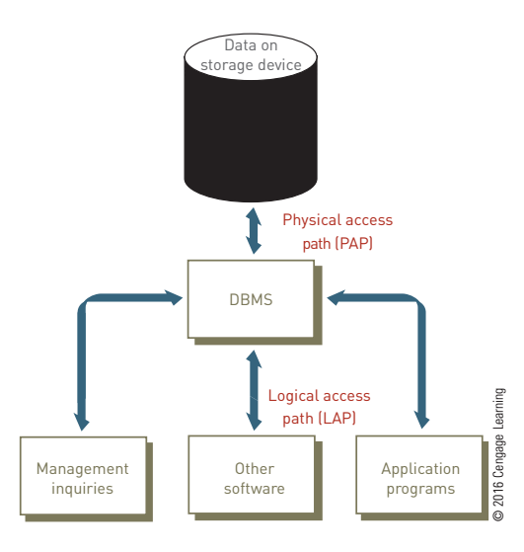
Storing and Retrieving Data
Notes:
This same process is used if a user wants to get information from the database. First, the user requests the data from the DBMS. For example, a user might give a command, such as LIST ALL OPTIONS FOR WHICH PRICE IS GREATER THAN $200. This is the logical access path (LAP). Then, the DBMS might go to the options price section of a disk to get the information for the user. This is the physical access path (PAP).

Slide 40
7. Database Administration
database administrators (DBAs): Skilled and trained IS professionals who hold discussions with users to define their data needs; apply database programming languages to craft a set of databases to meet those needs; test and evaluate databases; implement changes to improve their performance; and assure that data are secure from unauthorized access.

Slide 41
Database Administration: Data Administrator
Some organizations have also created a position called the data administrator, a nontechnical, but important position responsible for defining and implementing consistent principles for a variety of data issues, including setting data standards and data definitions that apply across all the databases in an organization. For example, the data administrator would ensure that a term such as “customer” is defined and treated consistently in all corporate databases.

Slide 42
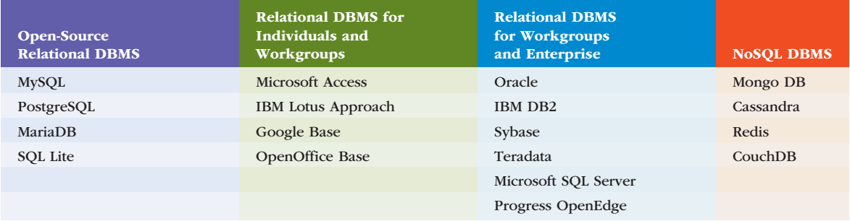
Database Management System: Popular Systems

Slide 43
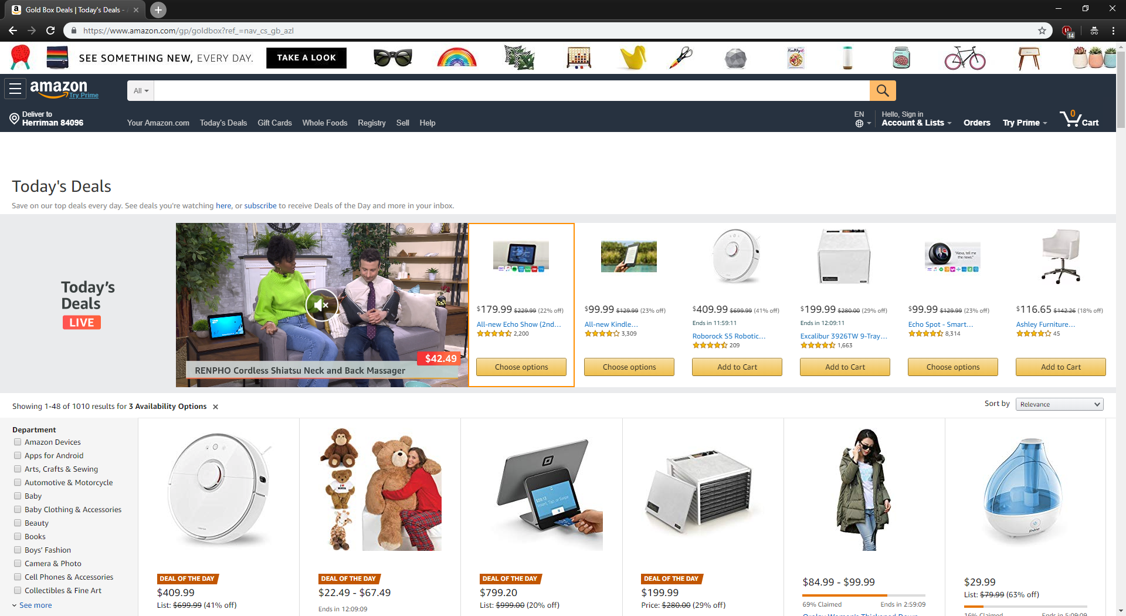
Database Management System: Using Databases
Notes:
Database management systems are often used with other software and with the Internet. A DBMS can act as a front-end application or a back-end application. A front-end application is one that people interact with directly. Marketing researchers often use a database as a front end to a statistical analysis program. The researchers enter the results of market questionnaires or surveys into a database. The data is then transferred to a statistical analysis program to perform analysis such as to determine the potential for a new product or the effectiveness of an advertising campaign. A back-end application interacts with other programs or applications; it only indirectly interacts with people or users. When people request information from a Web site, the site can interact with a database (the back end) that supplies the desired information.

Slide 44
7. Big Data

Slide 45
BIG DATA
Big data is the term used to describe data collections that are so enormous and complex that traditional data management software, hardware, and analysis processes are incapable of dealing with them.
Volume
In 2012, IBM estimated that the volume of data that exists in the digital universe was 2.7 zettabytes.
Velocity
The velocity at which data is currently coming at us exceeds 5 trillion bits per second.
Variety
Data comes in many varieties: structured and unstructured.
Notes:
Volume: 1 zettabyte is one sextillion (10²¹)
velocity : This is expected to double every 2 years.
Variety: Data today comes in a variety of formats. Some of the data is what computer scientists call structured data whose format is known in advance and fits nicely into traditional databases. An example of structured data is the well-defined business transactions that are used to update corporate databases containing customer, product, inventory, financial, and employee data. However, most of the data that an organization must deal with is unstructured data, meaning that it is not organized in any predefined manner. 21 Unstructured data comes from sources such as word-processing documents, social media, email, surveillance video, phone messages, and scientific research.

Slide 46
BIG DATA: In-Memory Databases
An in-memory database (IMDB) is a database management system that stores the entire database in random access memory (RAM). This approach provides access to data at rates of up to 100,000 times faster than storing data on some form of secondary storage (e.g., a hard drive or flash drive) as is done with traditional database management systems. IMDB is an enabler for the analysis of big data and other challenging data processing applications. IMDBs have become feasible because of the increase in RAM capacities and a corresponding decrease in RAM costs. In addition, in-memory databases perform best on multiple multicore CPUs that can process parallel requests to the data, further speeding access to and processing of large amounts of data.

Slide 47

Data Warehouse and Data Marts

Slide 48
DATA WAREHOUSES
A data warehouse is a database that holds business information from many sources in the enterprise, covering all aspects of the company’s processes, products, and customers. Data warehouses allow managers to drill down to get more detail or roll up to take detailed data and generate aggregate or summary reports. The primary purpose is to relate information in innovative ways and help managers and executives make better decisions.

Slide 49
ETL PROCESS
EXTRACT
TRANSFORM
LOAD
The goal of this process is to extract the source data from all the various sources and convert it into a single format suitable for processing.
During this stage of the ETL process, a series of rules or algorithms are applied to the extracted data to derive the data that will be stored in the data warehouse.
During this stage of the ETL process, the extracted and transformed data is loaded into the data warehouse.

Slide 50
DATA MARTS
A data mart is a subset of a data warehouse. Data marts bring the data warehouse concept—online analysis of sales, inventory, and other vital business data that has been gathered from transaction processing systems—to small and medium-sized businesses and to departments within larger companies. Rather than store all enterprise data in one monolithic database, data marts contain a subset of the data for a single aspect of a company’s business—for example, finance, inventory, or personnel.

Slide 51

BUSINESS INTELLIGENCE
DATA MINING
OLAP
BUSINESS INTELLIGENCE (BI)
Data mining is an information-analysis process that involves the automated discovery of patterns and relationships in a data warehouse.
OLAP allows users to explore data from a number of perspectives enabling a style of analysis known as“slicing and dicing.”
(BI) is a broad range of technologies and applications that enable an organization to transform mostly structured data obtained from information systems to perform analysis.
Notes:
Online Analytical Processing (OLAP)

Slide 52
DATA MINING: PREDICTIVE ANALYSIS
Predictive analysis is a form of data mining that combines historical data with assumptions about future conditions to predict outcomes of events, such as future product sales or the probability that a customer will default on a loan. The key element in predictive analytics is the predictor, one or more variables that can be measured for an individual to predict future behavior.

Slide 53

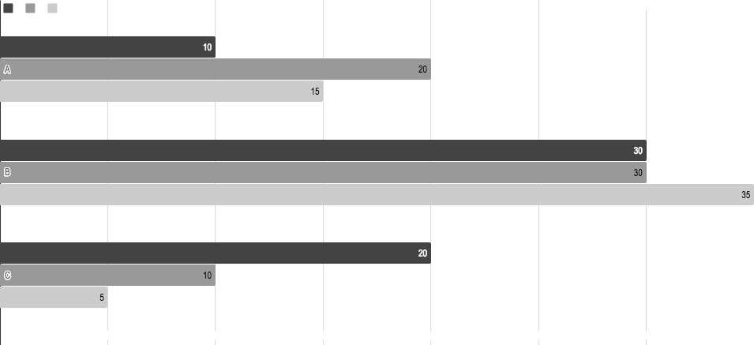
DATA VISUALIZATION
Notes:
One of the best ways to gain insights into data is through data visualization techniques that can help quickly draw conclusions and see relationships among the data. The analysis of big data brings additional challenges of trying to make sense out of the data. Excel, SAS Visual Analytics, and other software is available to prepare charts and graphs to make it easier to see trends and patterns and to identify opportunities for further analysis. Line charts, bar charts, scatter diagrams, bubble charts, and pie charts are frequently used.
Key performance indicators (KPIs) are quantifiable measurements that assess progress toward organizational goals and reflect the critical success factors of an organization.

Slide 54
THANKS!
Any questions?

Slide 55
CREDITS
Special thanks to all the people who made and released these awesome resources for free:
Presentation template by SlidesCarnival
Photographs by Unsplash

Slide 56
PRESENTATION DESIGN
This presentation uses the following typographies and colors:
Titles: Barlow Bold
Body copy: Barlow Normal
You can download the fonts on this page:
https://www.fontsquirrel.com/fonts/barlow
Yolk yellow #ffb000 · Dark gray #434343
You don’t need to keep this slide in your presentation. It’s only here to serve you as a design guide if you need to create new slides or download the fonts to edit the presentation in PowerPoint®

Slide 57
SlidesCarnival icons are editable shapes.
This means that you can:
Resize them without losing quality.
Change fill color and opacity.
Change line color, width and style.
Isn’t that nice? :)
Examples:

Slide 58
Now you can use any emoji as an icon!
And of course it resizes without losing quality and you can change the color.
How? Follow Google instructions https://twitter.com/googledocs/status/730087240156643328
😉
✋👆👉👍👤👦👧👨👩👪💃🏃💑❤😂😉😋😒😭👶😸🐟🍒🍔💣📌📖🔨🎃🎈🎨🏈🏰🌏🔌🔑 and many more...

